Slide 1
Music Recommendation System
Chunyang Jia
Yuxin Fan
Xiaoxuan Yu
Tingjun Wan
Notes:
Hello everyone! The topic of our project is music recommendation system. All of us are Meng students.

Slide 2
Content
01
02
Dataset
Pre-processing
03
Modeling and Evaluation
Introduction
04
Result and Cold Start
Notes:
We will introduce our project from the following aspects: . I will introduce the introduction and dataset pre-processing parts.

Slide 3
01
Introduction

Slide 4
01
Introduction
Dataset Description:
This dataset contains social networking, tagging, and music artists listening information from a set of 1892 users from Last.fm online music system
This dataset contains 1892 users, 17632 artists, 92834 user-listened artist relations, 11946 tags and 186479 tag assignments of artists from 2005 to 2011
Project Goal:
To recommend the best combination of 10 artists to each user based on listening counts and tags given by users

Slide 5
02
Data Pre-processing

Slide 6
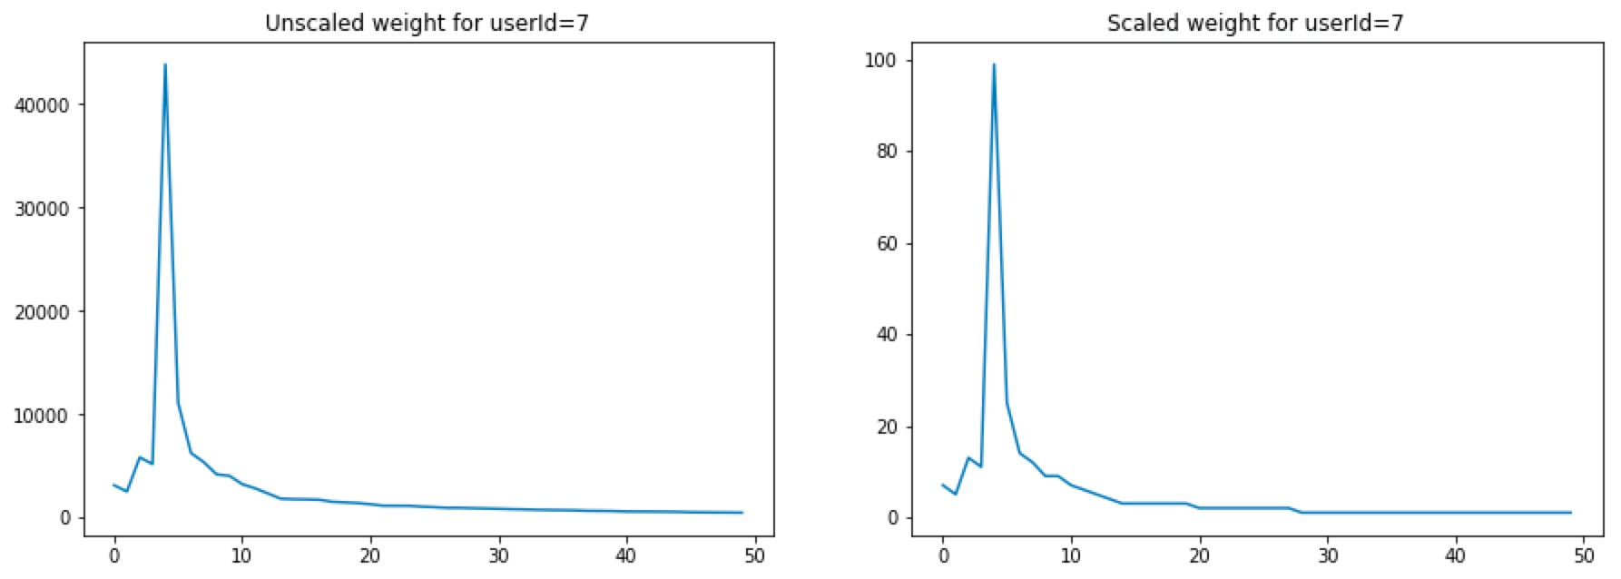
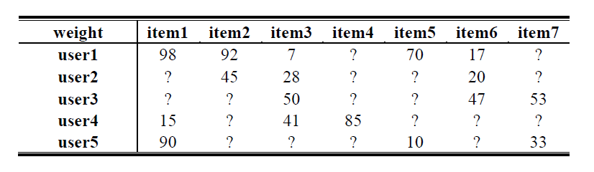
02
Data Pre-processing
Data normalization :
Scale original rating into [1:100]
Data splitting :
In model building part
10-fold cross-validation
In known rating data
Notes:
In order to get ratings of each user to artists they have listened, we normalize the weights. And scale them into [1:100]. As the normalization is for every user, the maximum and minimum of listening counts are different from users to users. User 7 is taken as the example to display changes before and after data scaling.
When splitting the data in model building part, we used 10-fold cross validation in known rating data to select algorithm and select similarity function. All of the known data were used to build the best model and then we used the best model to predict the unknown rating data.

Slide 7
03
Modeling

Slide 8
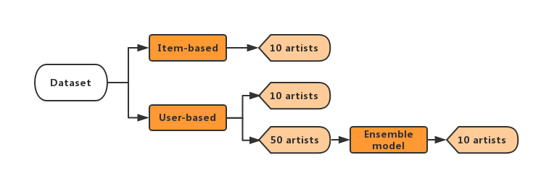
03
algorithm and similarity measure
03
Architecture
Notes:
It's the architecture of our project.
we build item-based and user-based system, which can recommend 10 artists for each user.
Then, we build ensemble model, actually, it's the combination of user based system and content-based system.
which also recommend 10artists.

Slide 9
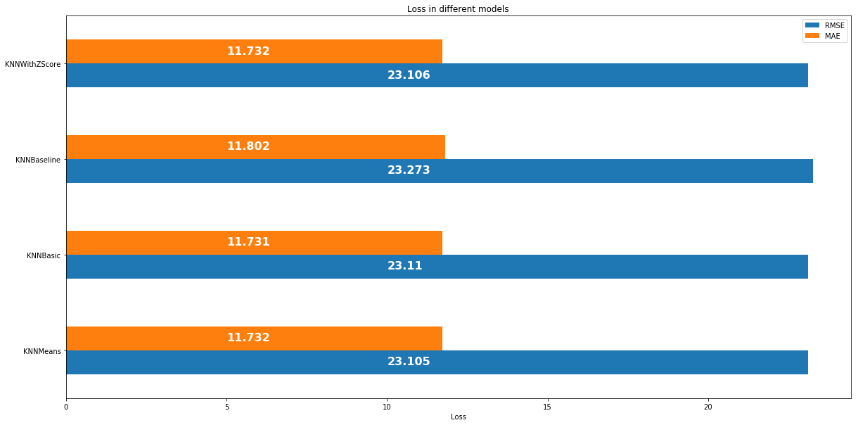
03
algorithm and similarity measure
Algorithm Choosing
KNNBasic, KNNWithMeans, KNNBaseline and KNNWithZscore
详细介绍作品的内容，详细介绍作品的内容，详细介绍作品的内容，详细介绍作品的内容，详细介绍作品的内容，详细介绍作品的内容。
Notes:
In algorithm choosing part, We tried four algorithms, including Knnbasic, knnwithmean, knnbaseline and knnwith z score.
those algorithms can predict the user ratings for items.
in the above four algorithms, Knnwithmeans has the smallest RMSE and MAE, so we choose it as the final algorithm.

Slide 10
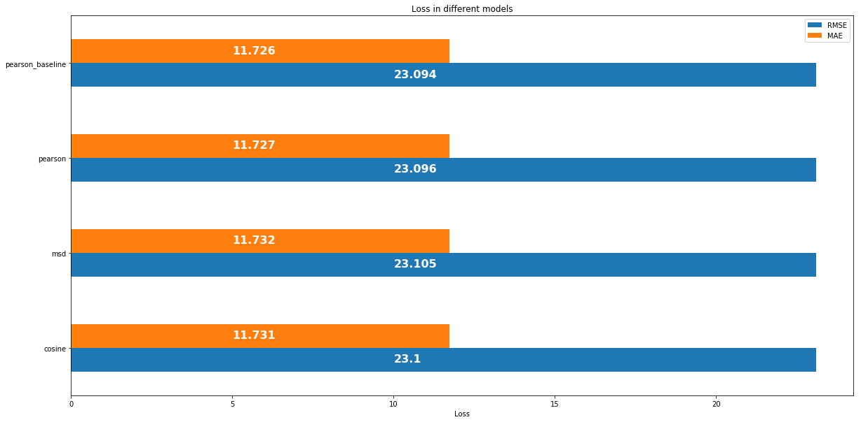
03
algorithm and similarity measure
Similarity Measure
cosine, pearson, pearson_baseline and MSD
详细介绍作品的内容，详细介绍作品的内容，详细介绍作品的内容，详细介绍作品的内容，详细介绍作品的内容，详细介绍作品的内容。
Notes:
The similarities module is the tools to compute similarity metrics between users or items.
pearson_baseline has the best result, which means it has the smallest RMSE and MAE .so we use it to calculate similarity in system.

Slide 11
03
Modeling – User Based Model
User Based Approach
KNNwithmeans and pearson_baseline similarity
input: known ratings similarity
output: unknown ratings
Rank ratings and recommend top 10 artists
Advantages: Find similar users and provide the user with artists that the similar users like. Similar people usually like similar stuff.
详细介绍作品的内容，详细介绍作品的内容，详细介绍作品的内容，详细介绍作品的内容，详细介绍作品的内容，详细介绍作品的内容。
Notes:
In user-based approach
Firstly, we calculate the similarity through pearson_baseline , and use knnwithmeans to predict the ratings.
In this model, The inputs are user's rating for different items, and outputs are the prediction of unknown ratings
Then we get those unknown values.
We rank those ratings, and for each user, we recommend top 10 artists users like but haven’t been heard

Slide 12
03
Modeling – Item Based Model
Item Based Approach
KNNwithmean and pearson_baseline similarity
Measure the similarity between two artists
The most similar 10 new artists will be recommended to the user
Number of aggregation : 40
Advantages: Similar items that meet the user’s taste will be more likely to attract the user’s attention.
详细介绍作品的内容，详细介绍作品的内容，详细介绍作品的内容，详细介绍作品的内容，详细介绍作品的内容，详细介绍作品的内容。
Notes:
As for item-based model.
The difference between user-based and item-based is the similarity, user-based is between users, and item-based is between items.
The (max) number of neighbors to take into account for aggregation is forty.

Slide 13
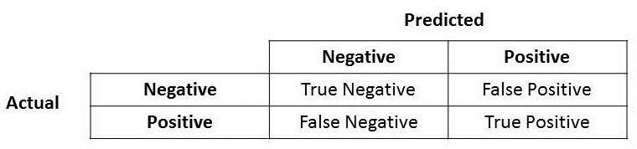

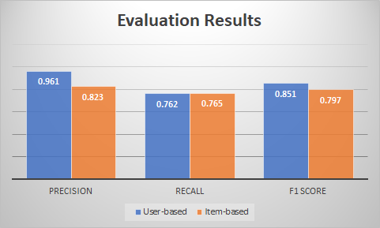


03
Evaluation
Precision, Recall and F1 Measure
threshold : the third quartile of rating (for every user)
higher than threshold: like (positive)
lower than threshold : dislike(negative)
Notes:
According to above models, we get the prediction from test set and compare them with their true values. Firstly we define the threshold as the third quartile of rating for each user. If the rating higher than the threshold, we could say that the user like this artist and regard it as positive result. Secondly we get the precision and recall for each model, then we get the F1-measure. The final precision and recall for user based model is 96% and 76%. In this case, the user based model has better performance with F1-measure 85%.

Slide 14
03
Modeling – Ensemble Model
Ensemble Model Approach
Build an artist-to-tag chart based on user tag file
Take top 50 artists from the user based model
Re-rank them based on user’s personal preference
Select the top 10 based on the new criteria
详细介绍作品的内容，详细介绍作品的内容，详细介绍作品的内容，详细介绍作品的内容，详细介绍作品的内容，详细介绍作品的内容。
Notes:
In ensemble model, we build a mapping of artist-to-tag and count the time of tag occurrence for each user. This result is also regarded as the weight for user-to-tag. According to this mapping we are able to identify the user's preference. Then we get top 50 artists from user base model as candidates for recommendation, calculate their weight for user-to-tag. And re-rank candidates, select the top 10 artist as our recommendation.

Slide 15
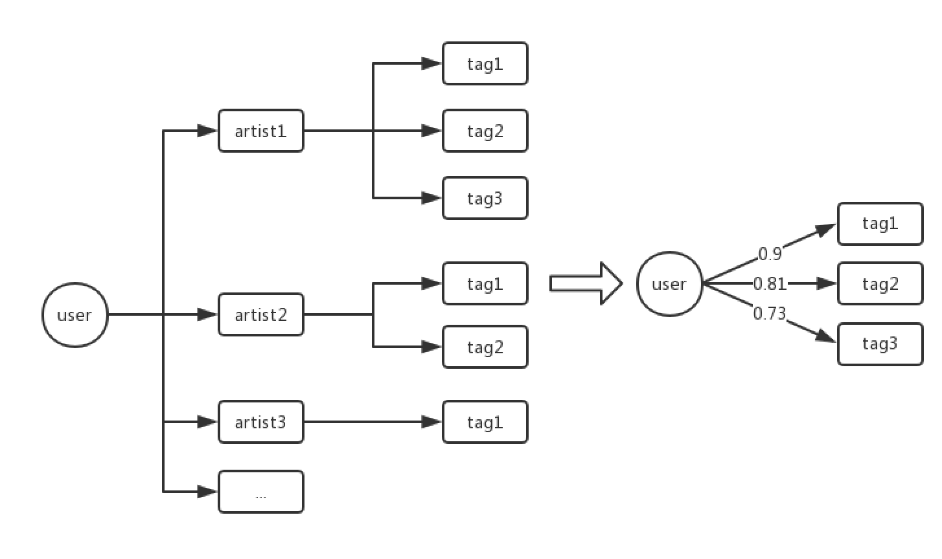
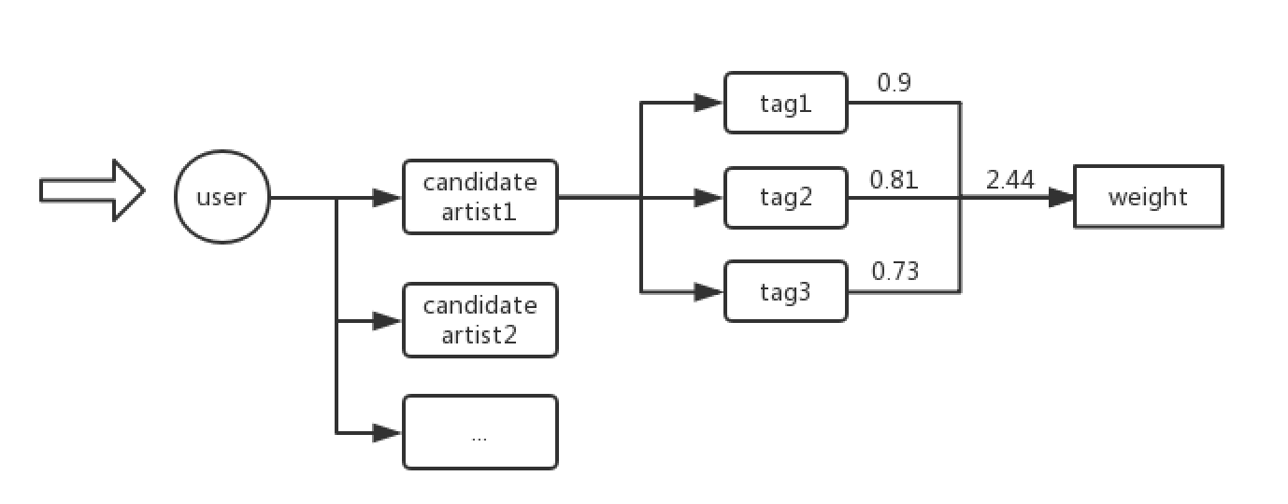
03
Modeling – Ensemble Model
Advantages: .
Guarantees relevance
Contains personal preference
Notes:
The whole process can be summarized as mapping user-to-tag table, counting and weighting tags, and ranking candidates based on the weight. This approach has the advantage that with the extra data available in the dataset, we not only consider based on user-to user similarities, but also could include the artist styles and user’s personal preference in the model.

Slide 16
04
Result and Cold Start

Slide 17
04
Result for User 7
User 7 in total has listened 50 artists
5 of the artists he likes:
Artist | Listen count | Weight | Thredshold
Rihanna | 43,864 | 99 | 4.95
Britney Spears | 11,112 | 25 | 4.95
Jordin Sparks | 6,266 | 14 | 4.95
Lady Gaga | 5,379 | 13 | 4.95
... | ... | ... | ...
详细介绍作品的内容，详细介绍作品的内容，详细介绍作品的内容，详细介绍作品的内容，详细介绍作品的内容，详细介绍作品的内容。
Notes:
Take user 7 as an example, there are 13 artists he may like, and 5 of them is list in this table.

Slide 18
03
04
Result for User 7
04
Top 10 recommend artist for user 7 in three models:
 | User_based | Item_based | Ensembled
1 | 65daysofstatic | Japan | ιχάλης Χατζηγιάννης
2 | IOSYS | Infected Mushroom | Alpha
3 | Ajda Pekkan | Tears for Fears | Quadrant, Dudley Taft,
4 | Gay Fairy Tales | UVERworld | F.L.A.B
5 | Nina | Blackmore‘s Night | Eraplee Noisewall Orchestra
6 | Mono Inc. | 雅-MIYAVI- | X-Patriate (Alan J. Lipman)
7 | Gary Revel | Noize MC | SMA
8 | Gridlock | Funeral for a Friend | Noel Rosa
9 | Dokken | Pulp | Bohren & der Club of Gore
10 | Split Enz | HYDE | Deja Vue
Notes:
There are 10 artist we will recommend to user 7 from different models.

Slide 19
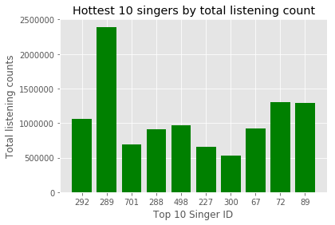
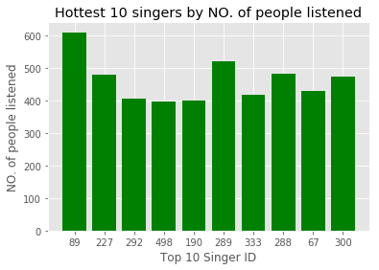
04
Cold Start
12 unique most popular artist selected by two approaches
10 top artists by total listening count
10 top artists by NO. of people listened
Then combine the two sets and randomly select 10 top artists from the 12 for each new user
289 – Britney Spears, 89 – Lady Gaga, 227 – the Beatles
详细介绍作品的内容，详细介绍作品的内容，详细介绍作品的内容，详细介绍作品的内容，详细介绍作品的内容，详细介绍作品的内容。
Notes:
2005-2011 listening history, roughly 1800 users
At the beginning of recommendation, there is not a large amount of effective user behavior data, which will bring the problem of "cold start". Without user behavior data, the content data of the product itself can be used. This is the early practice of recommendation systems.

Slide 20
Thank You

